Slide 1
CS4038
DATA MINING
LECTURE # 08
SPRING 2024
FAST – NUCES, CFD CAMPUS
AYESHA LIAQAT
ayesha.liaqat@nu.edu.pk

Slide 2
TODAY’S TOPICS
Data Preprocessing
Data transformation
Aggregation
Normalization
Attribute transformation
Binning
Discretization

Slide 3
FORMS OF DATA PREPROCESSING

Slide 4
DATA PREPROCESSING
DATA TRANSFORMATION

Slide 5
DATA TRANSFORMATION
A function that maps the entire set of values of a given attribute to a new set of replacement values
s.t. each old value can be identified with one of the new values.
Methods
Smoothing
Remove noise from data
Techniques: binning, regression, and clustering
Attribute/feature construction
New attributes constructed from the given ones
Aggregation
Summarization, data cube construction

Slide 6
DATA TRANSFORMATION
A function that maps the entire set of values of a given attribute to a new set of replacement values s.t. each old value can be identified with one of the new values.
Methods
Normalization: Attribute data scaled to fall within a smaller, specified range, such as: -1.0 to 1.0, or 0.0 to 1.0
Techniques: min-max normalization, z-score normalization, normalization by decimal scaling
Discretization: Raw values of numeric attribute (e.g., age) are replaced by interval labels (e.g., 0-10, 11-20, etc.) or conceptual labels (e.g., youth, adult, senior)

Slide 7
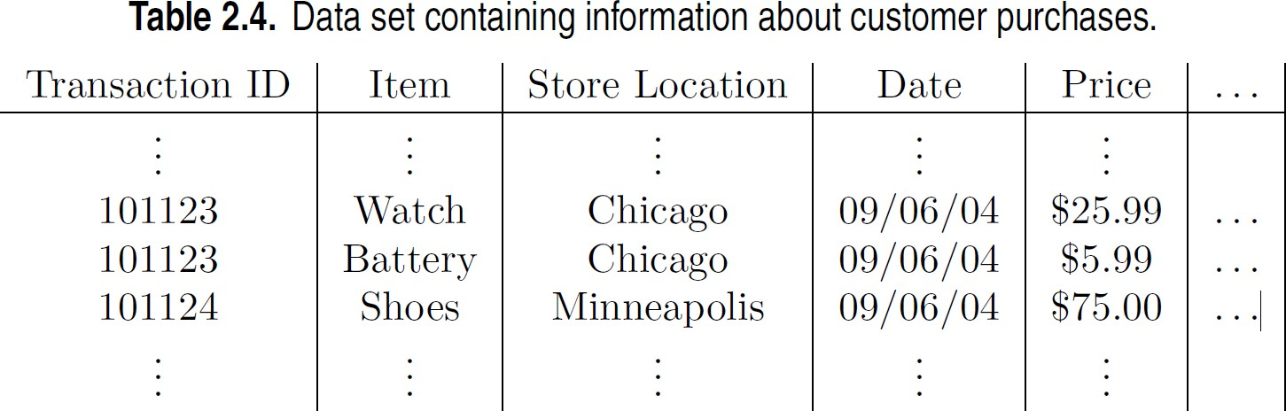
AGGREGATION
Combining two or more attributes (or objects) into a single attribute (or object)
Purpose
Data reduction - reduce the number of attributes or objects
Change of scale
Cities aggregated into regions, states, countries, etc.
Days aggregated into weeks, months, or years
More “stable” data - aggregated data tends to have less variability
Notes:
Monthly sales data instead of Daily sales data.Less is more. Thousands of transaction into-→Single daily transaction. How? Quantitative as mean/avg and qualitative as omitted/set of all items.
Reducing possible values e.g.. For Date into months. Used in OLAP
Motivation: 1) less time and memory so more expensive algo use 2) change of scale as high level view instead of low level view 3) more stable behaviour

Slide 8
EXAMPLE: PRECIPITATION IN AUSTRALIA
This example is based on precipitation in Australia from the period 1982 to 1993.
The next slide shows
A histogram for the standard deviation of average monthly precipitation for 3,030 0.5◦ by 0.5◦ grid cells in Australia, and
A histogram for the standard deviation of the average yearly precipitation for the same locations.
The average yearly precipitation has less variability than the average monthly precipitation.
All precipitation measurements (and their standard deviations) are in centimeters.

Slide 9
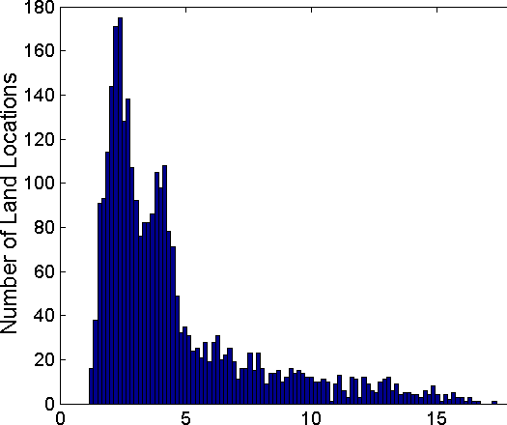
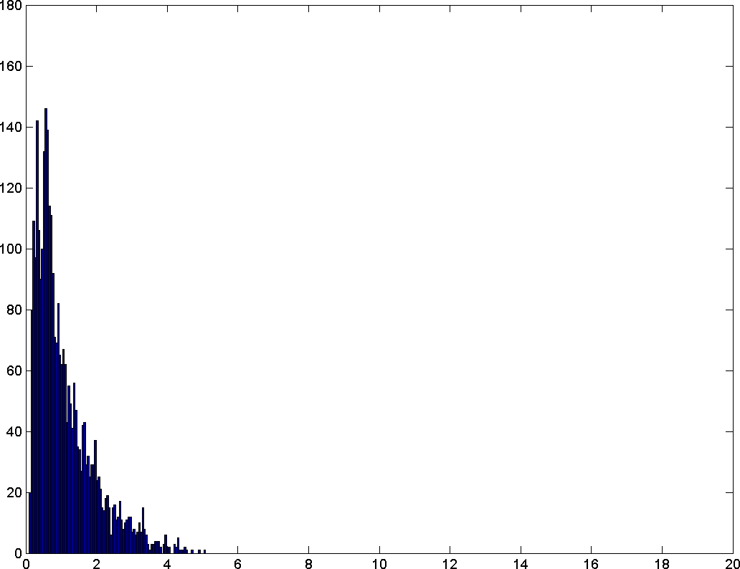
EXAMPLE: PRECIPITATION IN AUSTRALIA …
Variation of Precipitation in Australia
Standard Deviation of Average Monthly Precipitation
Standard Deviation of Average Yearly Precipitation
Notes:
Disadv: potential loss of interesting details. In the store example aggregating over months loses information about which day of the week has the highest sales

Slide 10
NORMALIZATION (OR STANDARDIZATION)
Numeric attribute data scaled to fall within a smaller, specified range, such as: -1.0 to 1.0, or 0.0 to 1.0.
Normalization attempts to give all data attributes an equal weight.
Useful for classification algorithms mainly involving distance measurements and clustering
Standardization means different here from how it is used in statistics.

Slide 11
NORMALIZATION (OR STANDARDIZATION)
Min-max normalization values typically range between 0 and 1
v’ = v – min(v) = v – min(v)
range(v) max(v) – min(v)
Example: Let income range $12,000 to $98,000.Then $73,600 is mapped to:
v’ = 73600 – 12000
98000 - 12000
= 61600 = 0.716
86000
Notes:
When need to scale data to a specific range. When no outliers in data. Preserves the relative relationship between datapoints

Slide 12
NORMALIZATION (OR STANDARDIZATION)
Min-max normalization to [new_min_{A}, new_max_{A}]
v − minA maxA − minA
v' =
(new _ maxA − new _ minA) + new _ minA
Example: Let income range $12,000 to $98,000 normalized to [1.0, 5.0]. Then $73,600 is mapped to:
v’ = 73600 – 12000 (5.0 – 1.0) + 1.0
98000 - 12000
= 61600 (4) + 1 = 3.864
86000

Slide 13
NORMALIZATION (OR STANDARDIZATION)
Z-score standardization: (μ: mean, σ: standard deviation):
_{v' =} v − μA
σA
Example: Let μ = 54,000, σ = 16,000. Then:
73,600 − 54,000 _{= 1.225}
16,000
Data values that lie below mean will have a negative z-score standardization. Data values falling exactly on the mean will have a zero z-score standardization. Data values that lie above the mean will have a positive z-score standardization.
Notes:
For uniform distr.

Slide 14
NORMALIZATION (OR STANDARDIZATION)
Z-score standardization: (μ: mean, σ: standard deviation):
_{v' =} v − μA
σA
Z-score methods states that a data value is an outlier if it has a Z-score that is either less than -3 or greater than 3.
Caveat: when choosing a method for evaluating outliers, it may not seem appropriate to use measures that are themselves sensitive to their presence.
Notes:
When required mean of zero and std dev of 1

Slide 15
NORMALIZATION (OR STANDARDIZATION)
Normalization by decimal scaling: normalizes by moving the decimal point of values of attribute A.Values lie between -1 and 1.
Number of decimal points moved depends on the largest absolute value of A.
v
10 ^{j}
v' =
Where j is the no. of digits in the largest absolute value of v
Example: Let the values recorded for attribute A range from -986 to 917. Max absolute value of A is 986. We, therefore, divide each value by 1000 (i.e., j=3) so that -986 normalizes to -0.986 and 917 normalizes to 0.917.
Notes:
Useful when range of data varies significantly and maintains the order of the magnitude of the data making it suitable for datasets with large variations in magnitude

Slide 16
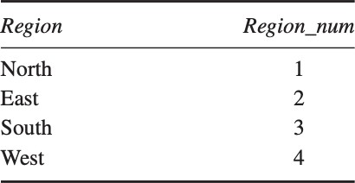
TRANSFORMING CATEGORICAL VARIABLES INTO NUMERICAL VARIABLES
An intuitive approach is to simply transform a categorical variable into numerical, for example,
The algorithm now erroneously thinks the followings:
The four regions are ordered
West > South > East > North
West is three times closer to South compared to North, and so on.

Slide 17
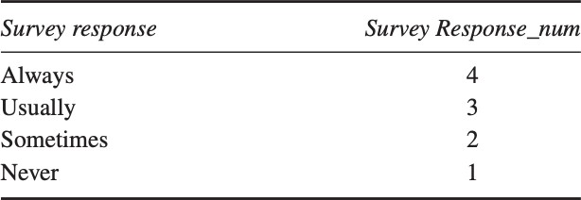
TRANSFORMING CATEGORICAL VARIABLES INTO NUMERICAL VARIABLES
Only use this conversion for specific categorical variables which are ordered, for example
Careful assignment of the numerical values is important

Slide 18
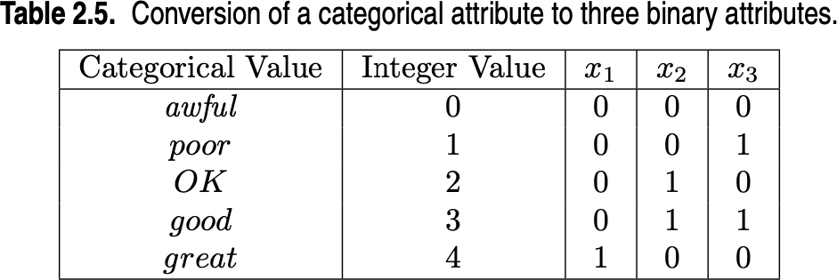
BINARIZATION
Binarization maps a continuous or categorical attribute into one or more binary variables.
Method:
For a categorical attribute with m values, uniquely assign each original value to an integer in the interval [0, m-1].
Convert each of these m integers to a binary number.
Notes:
Problem: r/p may be identified as for good value

Slide 19
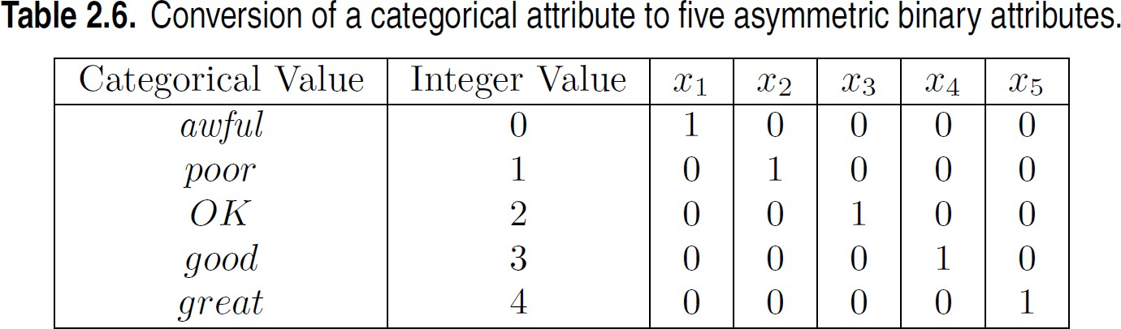
BINARIZATION
Sometimes, it is necessary to introduce one binary attribute for each categorical values (e.g., in association analysis).
Also known as “one hot encoding”.
Notes:
Association analysis require asymmetric binary attr where only presence is important.

Slide 20
ATTRIBUTE TRANSFORMATION
An attribute transform is a function that maps the entire set of values of a given attribute to a new set of replacement values such that each old value can be identified with one of the new values
Simple functions: x^{k}, log(x), e^{x}, |x|
Normalization
Refers to various techniques to adjust to differences among attributes in terms of frequency of occurrence, mean, variance, range
Take out unwanted, common signal, e.g., seasonality

Slide 21
DISCRETIZATION
Discretization is the process of converting a continuous attribute into an ordinal attribute
A potentially infinite number of values are mapped into a small number of categories
Discretization is used in both unsupervised and supervised settings
26

Slide 22
DATA DISCRETIZATION METHODS
Typical methods: All the methods can be applied recursively
Binning (top-down split, unsupervised)
Histogram analysis (top-down split, unsupervised)
Clustering analysis (unsupervised, top-down split or bottom-up merge)
Decision-tree analysis (supervised, top-down split)
Correlation (e.g., χ²) analysis (unsupervised, bottom-up merge)
28
28

Slide 23
DISCRETIZATION BY CLASSIFICATION & CORRELATION ANALYSIS
Classification (e.g., decision tree analysis)
Supervised: Given class labels, e.g., cancerous vs. benign
Using entropy to determine split point (discretization point)
Top-down, recursive split
Correlation analysis (e.g., Chi-merge: χ²-based discretization)
Supervised: use class information
Bottom-up merge: find the best neighboring intervals (those having similar distributions of classes, i.e., low χ2 values) to merge
Merge performed recursively, until a predefined stopping condition
29
28

Slide 24
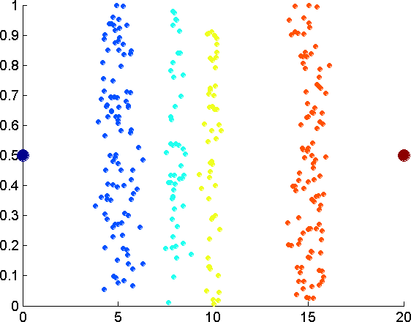
UNSUPERVISED DISCRETIZATION
Data consists of four groups of points and two outliers. Data is one- dimensional, but a random y component is added to reduce overlap.

Slide 25
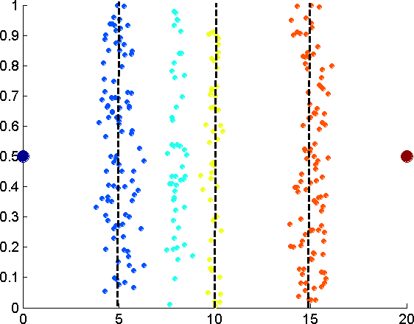
UNSUPERVISED DISCRETIZATION
Equal interval width approach used to obtain 4 values.

Slide 26
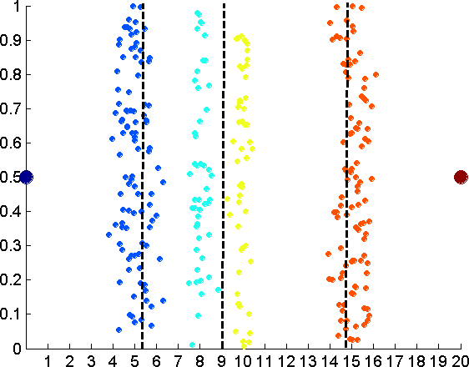
UNSUPERVISED DISCRETIZATION
Equal frequency approach used to obtain 4 values.

Slide 27
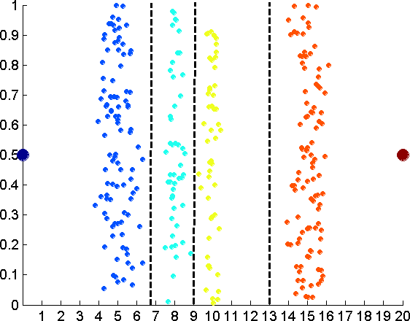
UNSUPERVISED DISCRETIZATION
K-means approach to obtain 4 values.

Slide 28
UNSUPERVISED DISCRETIZATION (BINNING VS. CLUSTERING)
Data
Equal interval width
(binning)
Equal frequency (binning)
K-means clustering leads to better results
34

Slide 29
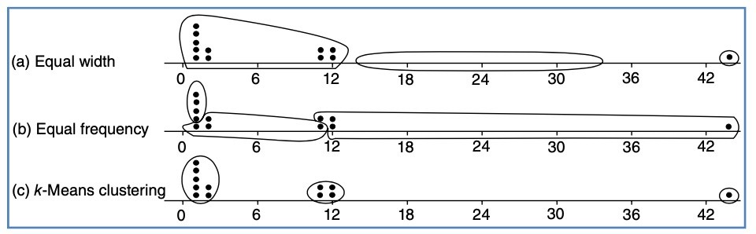
UNSUPERVISED DISCRETIZATION (BINNING VS. CLUSTERING)

Slide 30
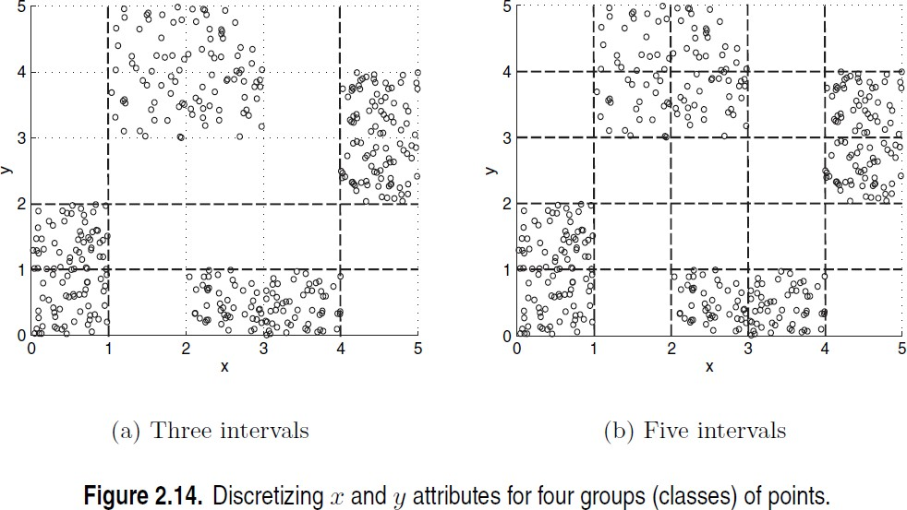
DISCRETIZATION IN SUPERVISED SETTINGS
Many classification algorithms work best if both the independent and dependent variables have only a few values
We give an illustration of the usefulness of discretization using the following example.

Slide 31
SIMPLE DISCRETIZATION: BINNING
Equal-width (distance) partitioning
Divides the range into N intervals of equal size: uniform grid
if A and B are the lowest and highest values of the attribute, the width of intervals will be: W = (B –A)/N.
The most straightforward, but outliers may dominate presentation
Skewed data is not handled well
Equal-depth (frequency) partitioning
Divides the range into N intervals, each containing approximately same number of samples
Good data scaling
Managing categorical attributes can be tricky

Slide 32
READING MATERIAL
Chapter 2:Tan, Steinbach & Kumar
Chapter 3: Han, Kamber & Pei
47

